Slide 1
Rescue Robot
“The Invincibles”
Yahia Mesharaf
Brian Visas
Enkeledi Mema
Hermann Anguiga
Aluko Tunde Oluwayemi
Hint: that’s just a rough draft of the presentation not the one we will really present

Slide 2
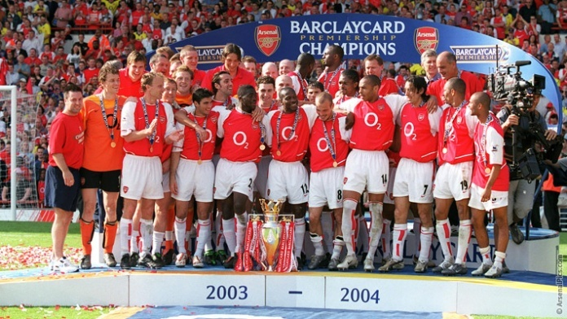
Why the Invincibles?
Arsenal 2004

Slide 3
Diagrams on System Architecture:
Use case D. → → Requirement D. → → Block Diagram
Subsystem Realization:
Relation between Subsystems as well as algorithms

Slide 4
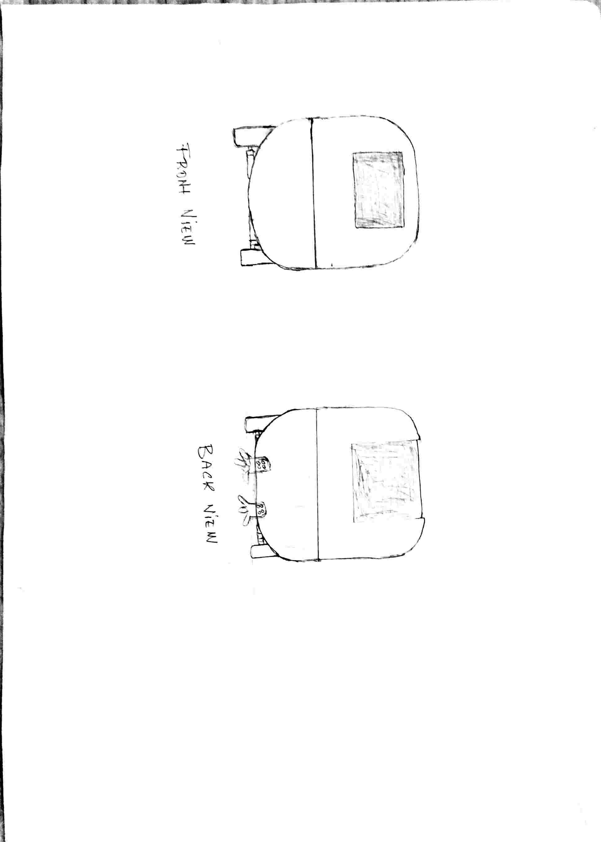
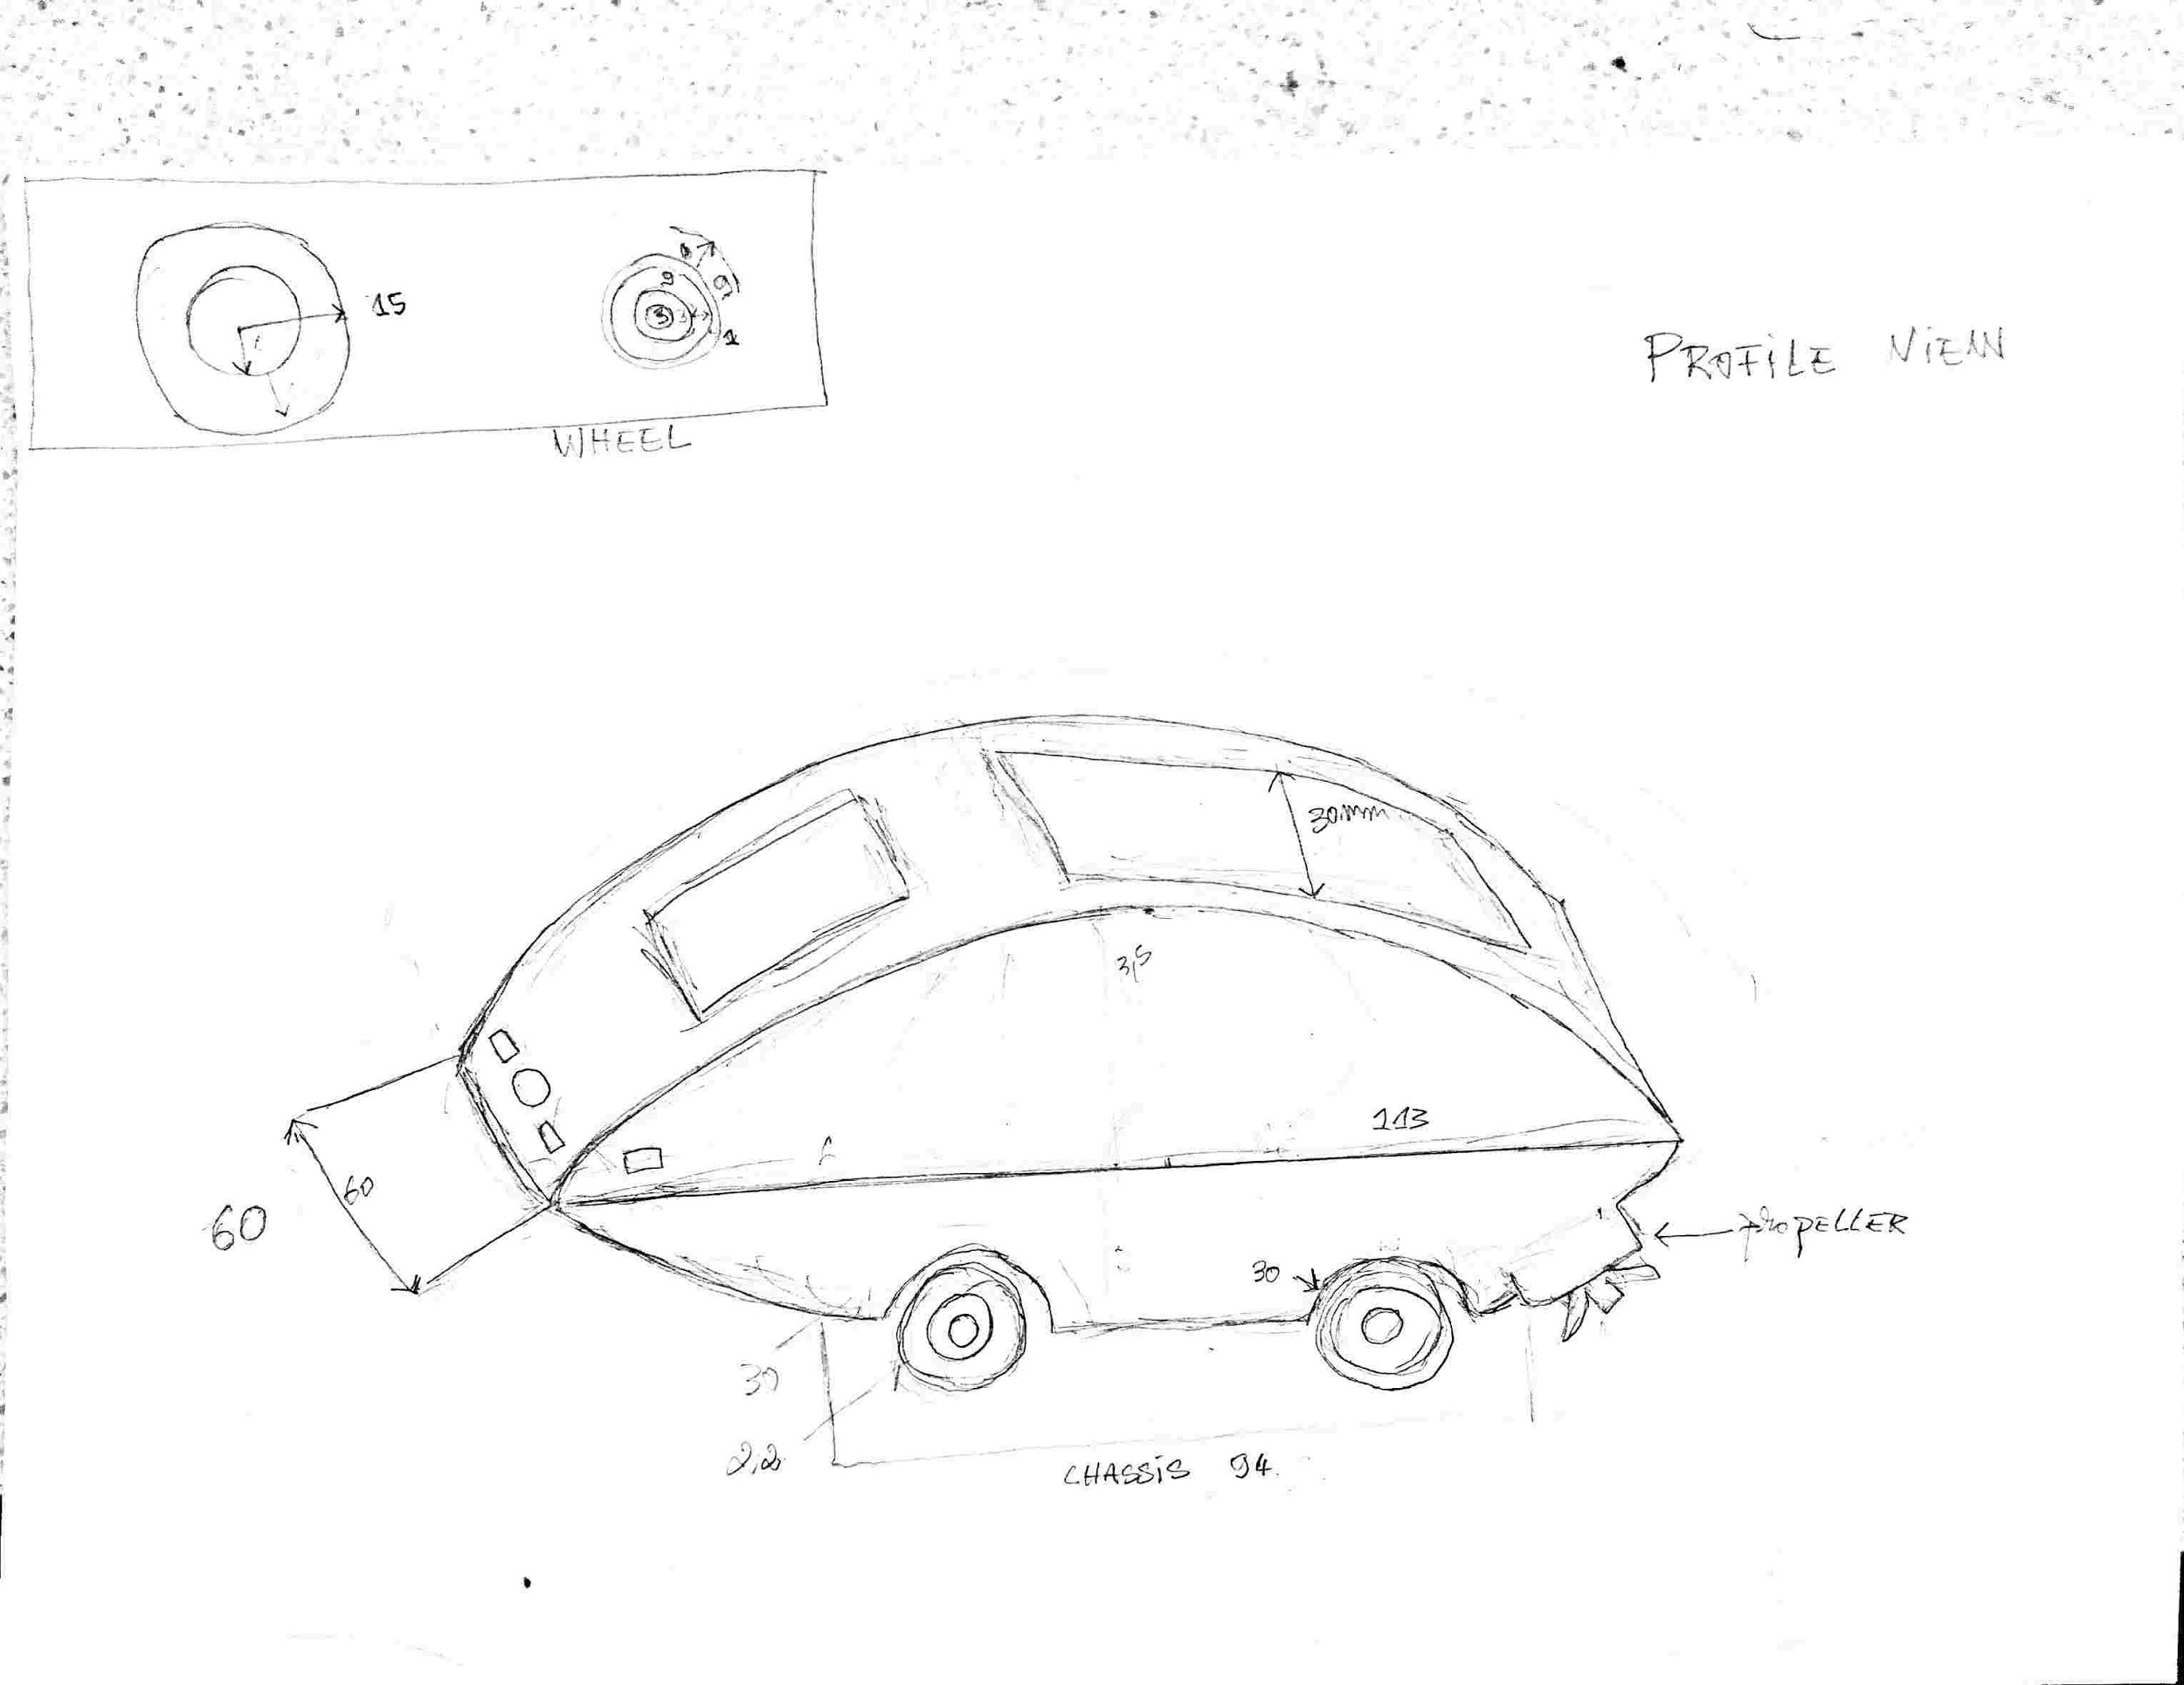
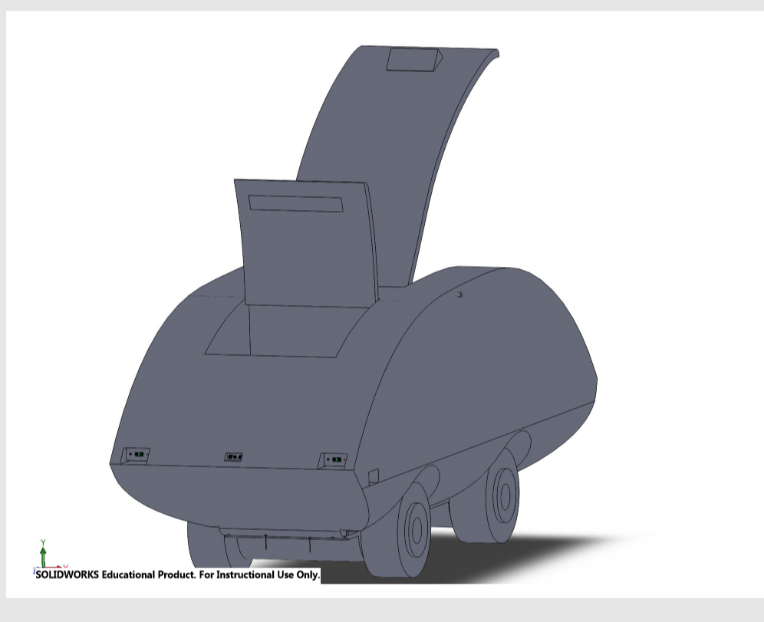
3D Model
Conception
Layout
- General structure
Affordances and Signifiers
General Scenario

Slide 5
Conception
Why this shape?

Slide 6
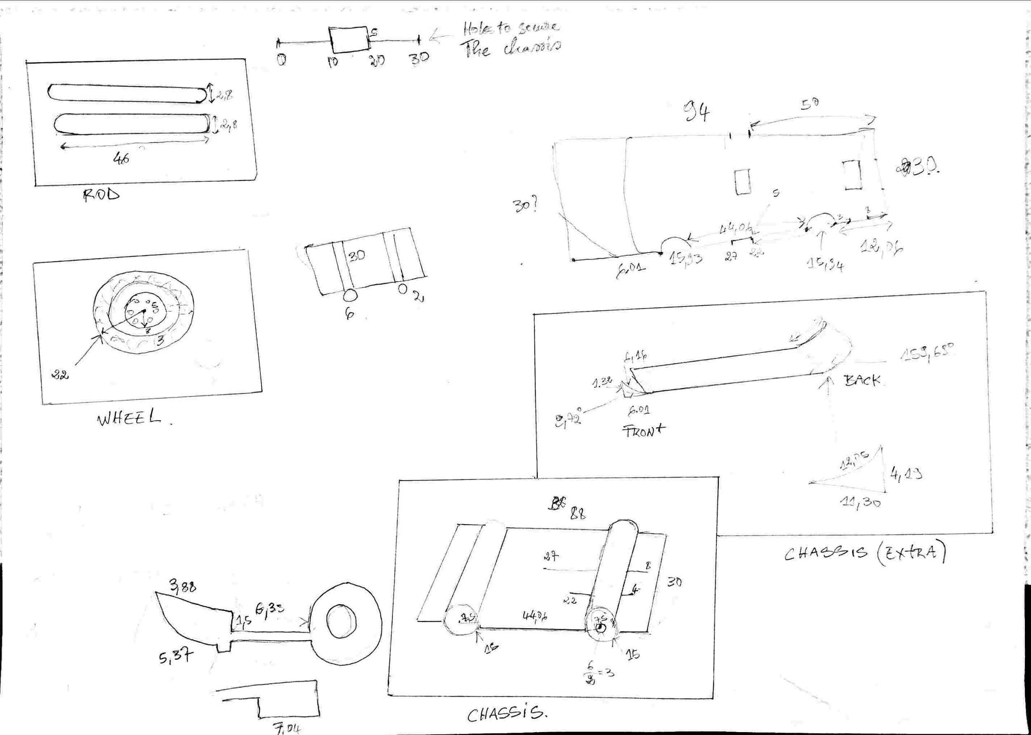
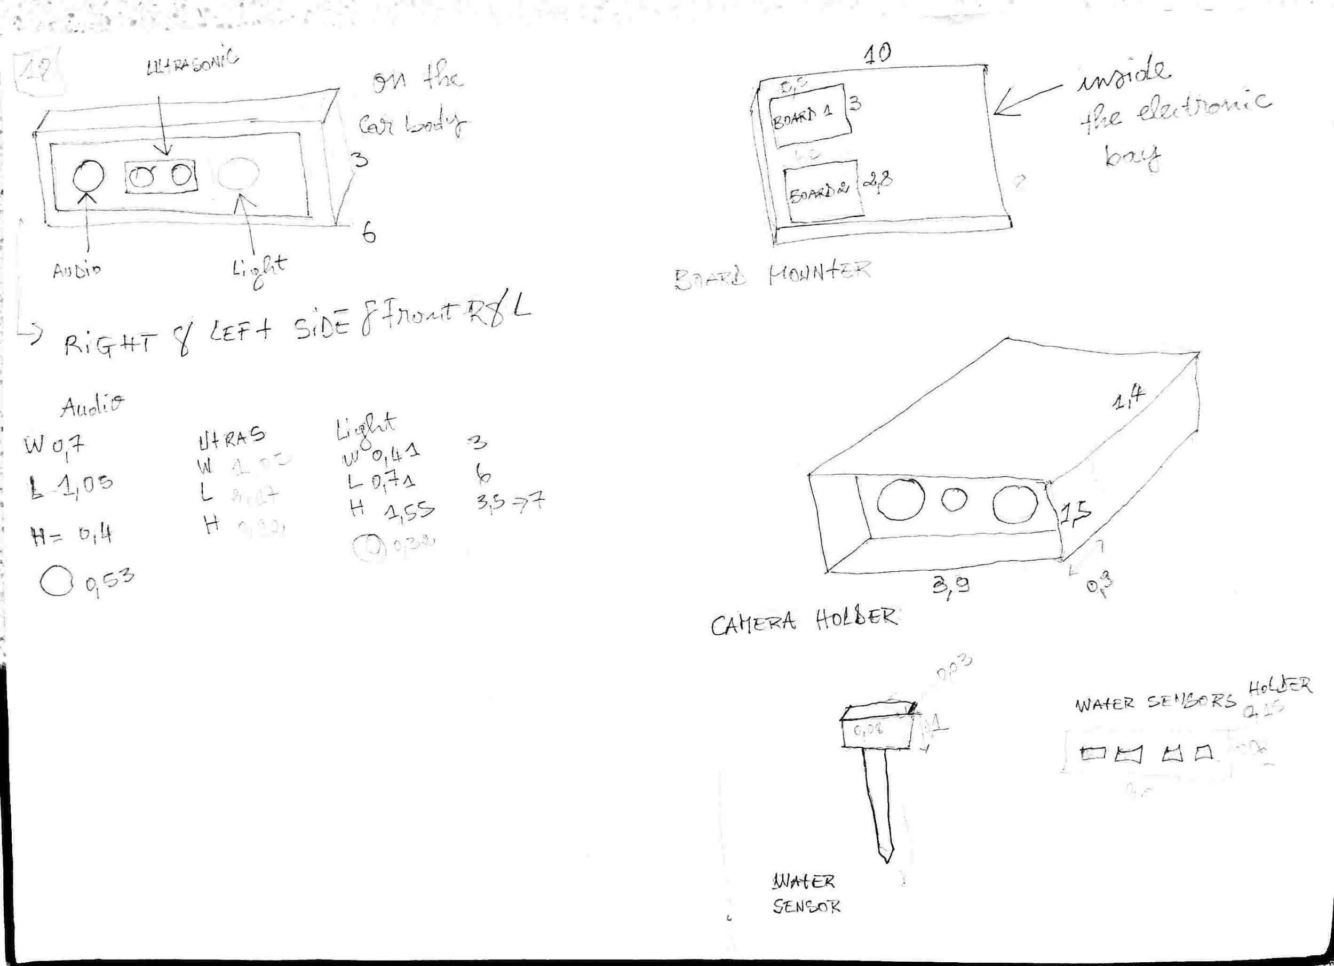
Layout
The Body
The Chassis
The Sensors and Boards holders

Slide 7
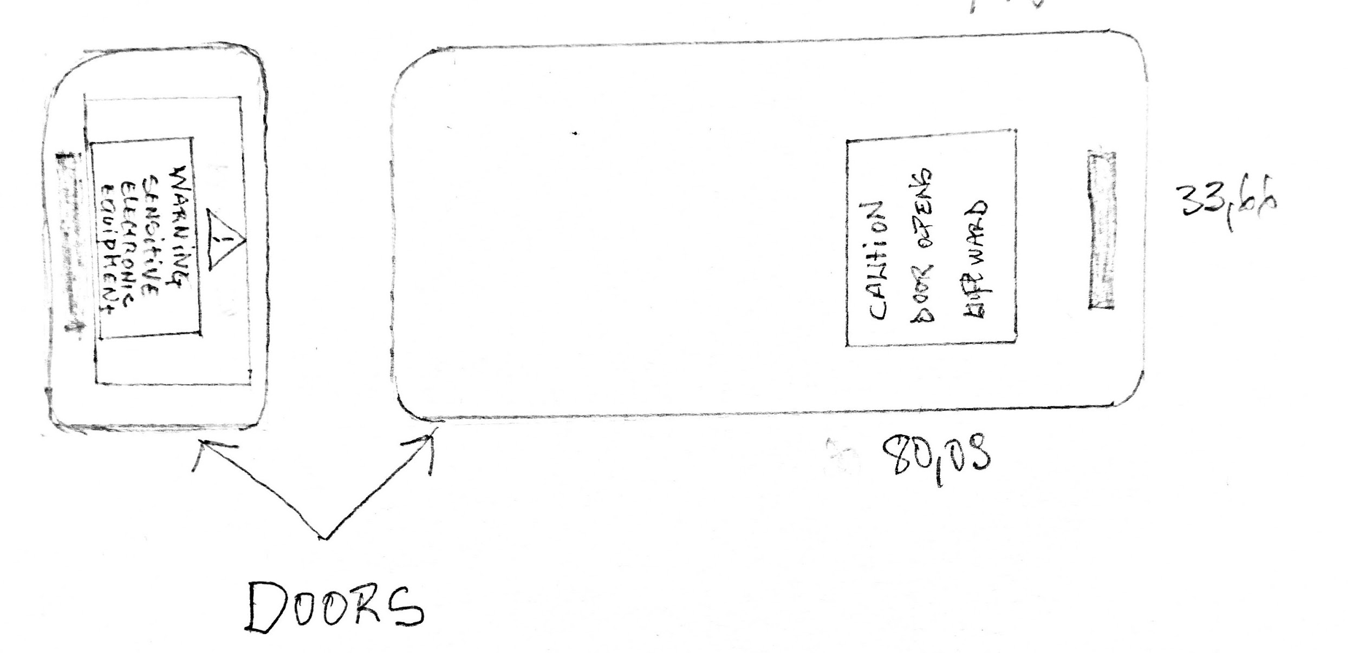
Affordances and Signifiers

Slide 8
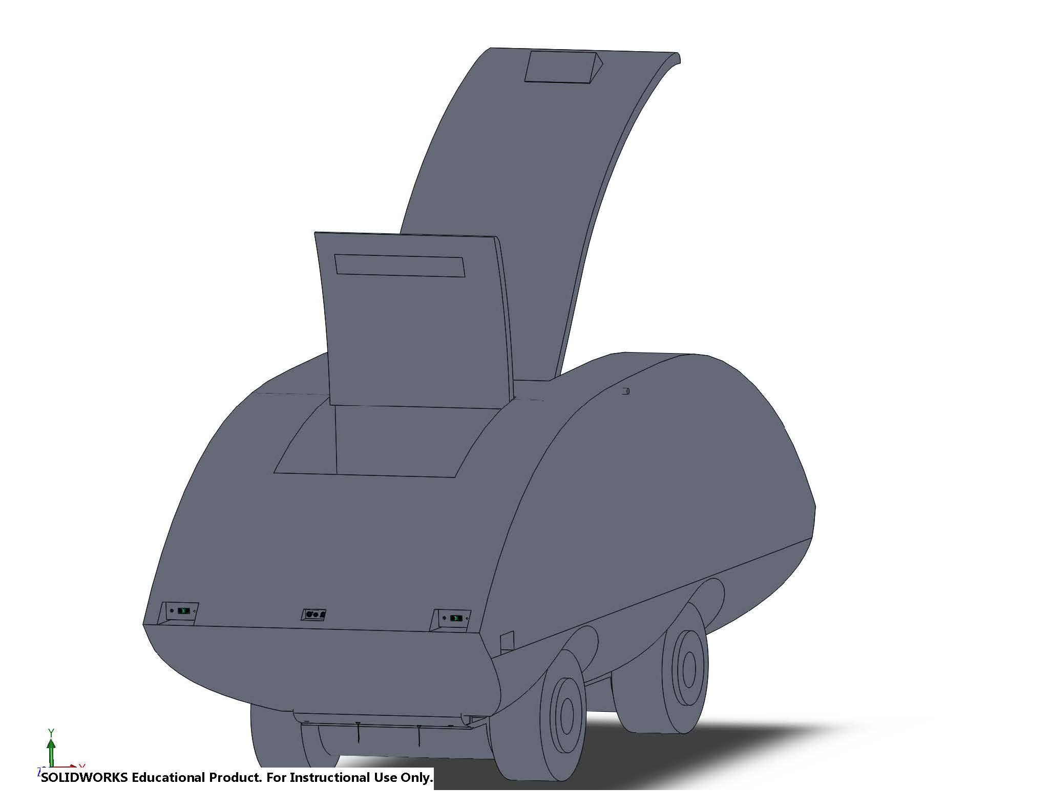
General Scenario
The Final 3D Model

Slide 9
Simulations:
Videos
Softwares
A Look into the Future ..

Slide 10
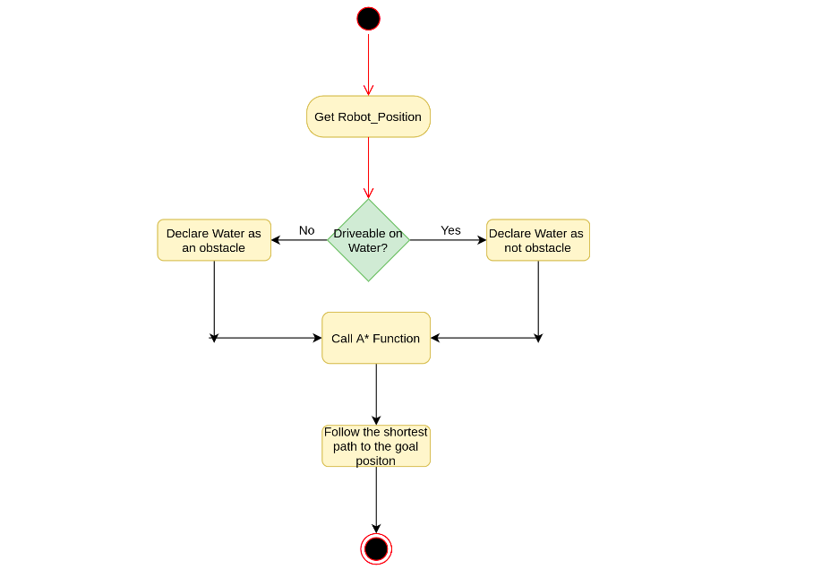
Driving Algorithm

Slide 11
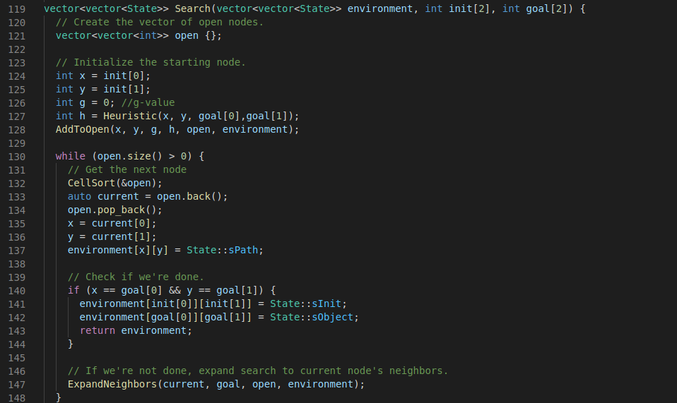
A* Shortest Path Algorithm Implementation

Slide 12
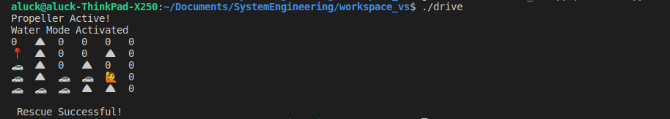
Test Case Result
The test result shows how our driving actually avoid obstacles and choose the shortest path to goal destination.

Slide 13
Implementation
Video for hardware simulation.

Slide 14
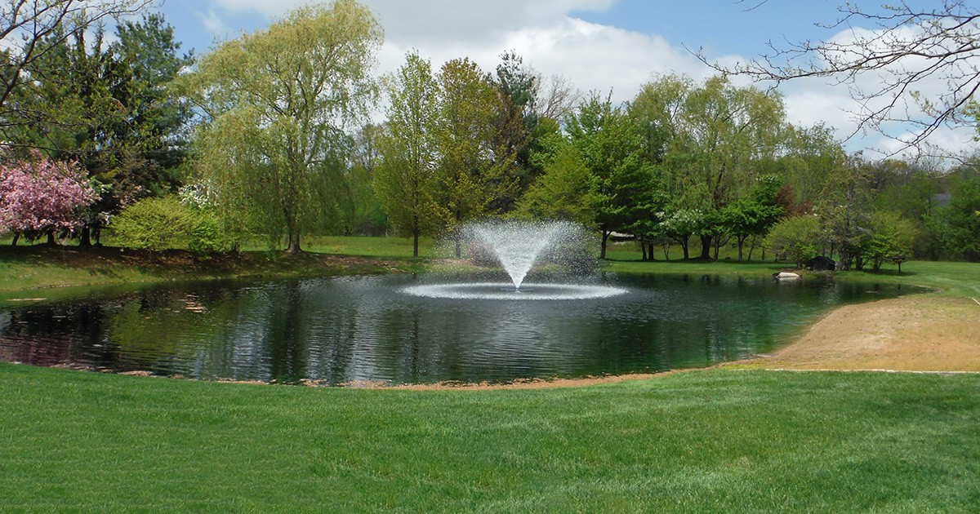
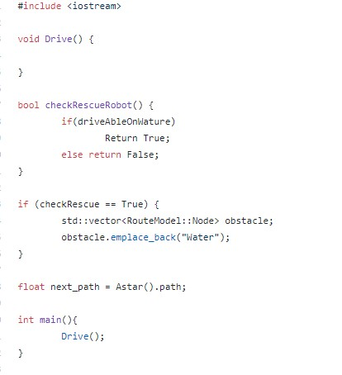
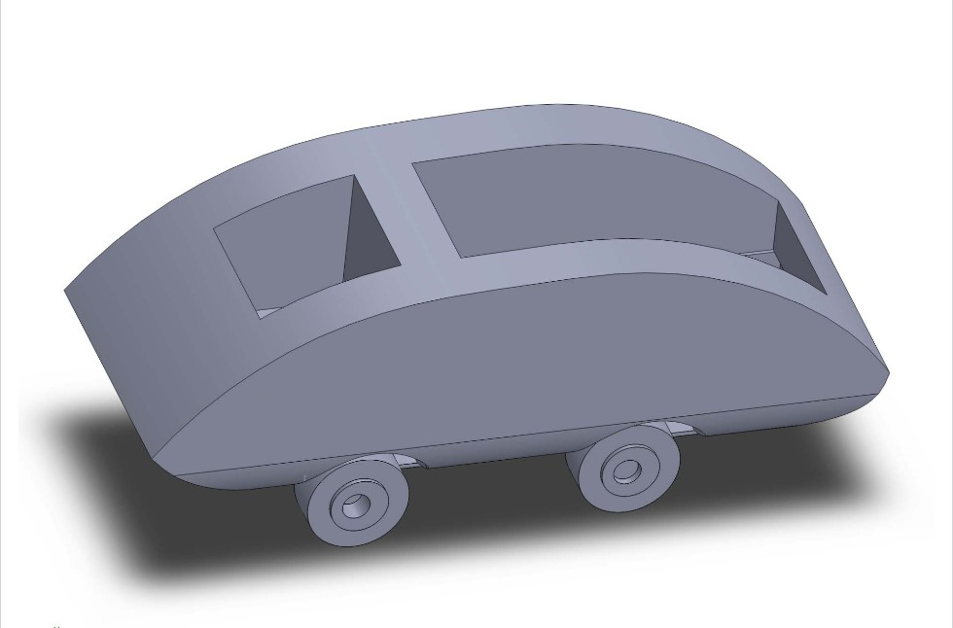
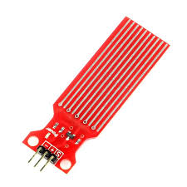

Slide 15
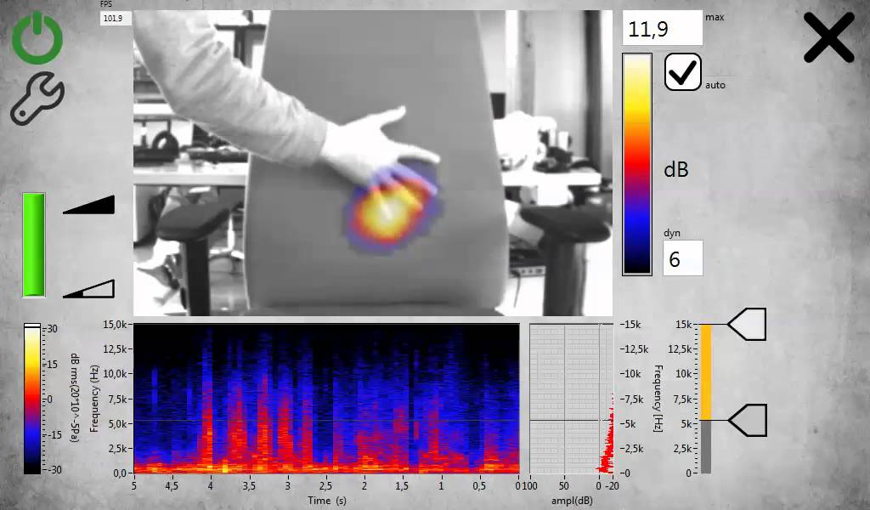
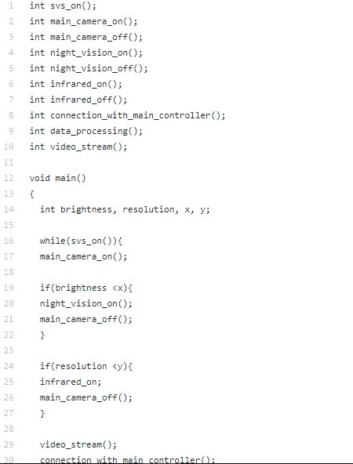
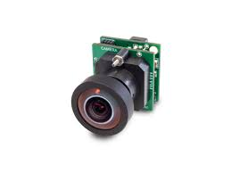

Slide 16
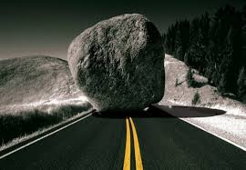
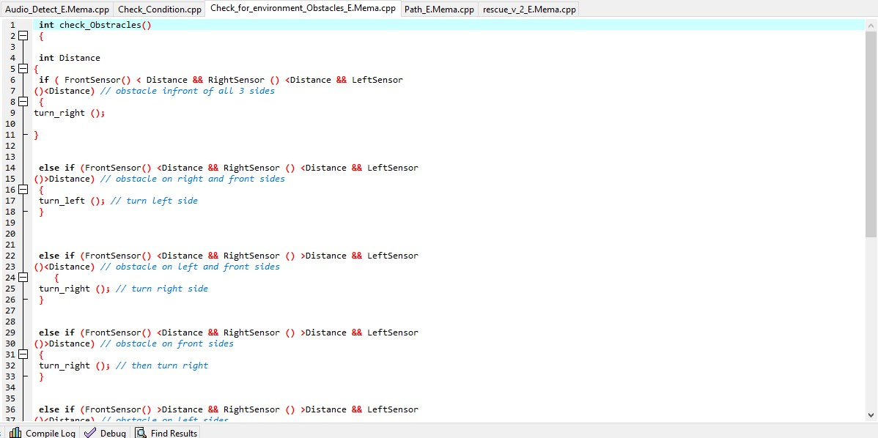
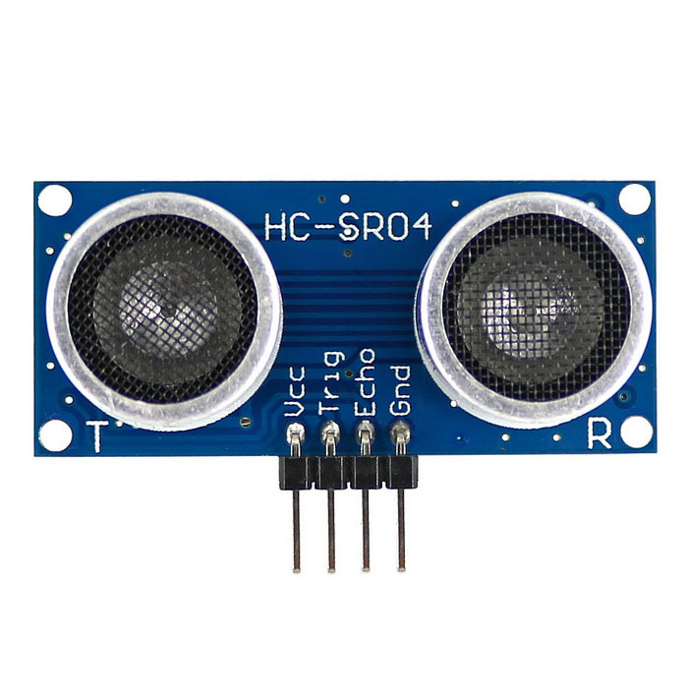

Slide 18
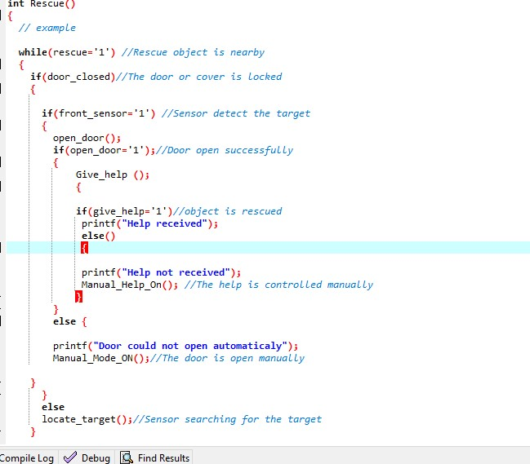



Slide 19
